Slide 1
Sleeping Disorders
In depth Analyzes

Slide 2
AGENDA
01
Acquisition
04
Analyzes
Objective
Initial Analyzes
Part 1
Part 2
Part 3
Part 4
02
Cleansing
05
Data Storage
Data Integrity
Solutions
Github
03
Transformation
06
Final Thoughts
Issues
Solutions
Questions
Thank You

Slide 3
01
Acquisition

Slide 4

Objective
Acquiring the dataset to analyze sleep health within individuals.
Dataset was acquired from Kaggle
https://www.kaggle.com/datasets/uom190346a/sleep-health-and-lifestyle-dataset
Individual for the dataset is Laksika Tharmalingam
86.3 K downloads
Use for Education Purposes
In this dataset we want to analyze the information to draw meaningful conclusions, using R programming

Slide 5
Person ID
Age
Sleep Duration
Quality of Sleep
Physical Activity Level
Stress Level
Blood Pressure
Heart Rate
Daily Steps
Numerical Categories
Categorical Categories
Gender
Occupation
BMI Category
Sleep Disorder
Initial ANALYSIS
Dataset has 13 categorical variables and 374 observations.

Slide 6
02
Cleansing

Slide 7

Data Integrity
When getting data we must cleanse any possible issues
Missing Values
Remove Rows
Impute Missing Values
Fix inconsistent Data
Remove Duplicates
Check for Outliers
80
70
60
50
40
30
20
10
BAR GRAPH INFO 1
BAR GRAPH INFO 1
BAR GRAPH INFO 1
BAR GRAPH INFO 1

Slide 8

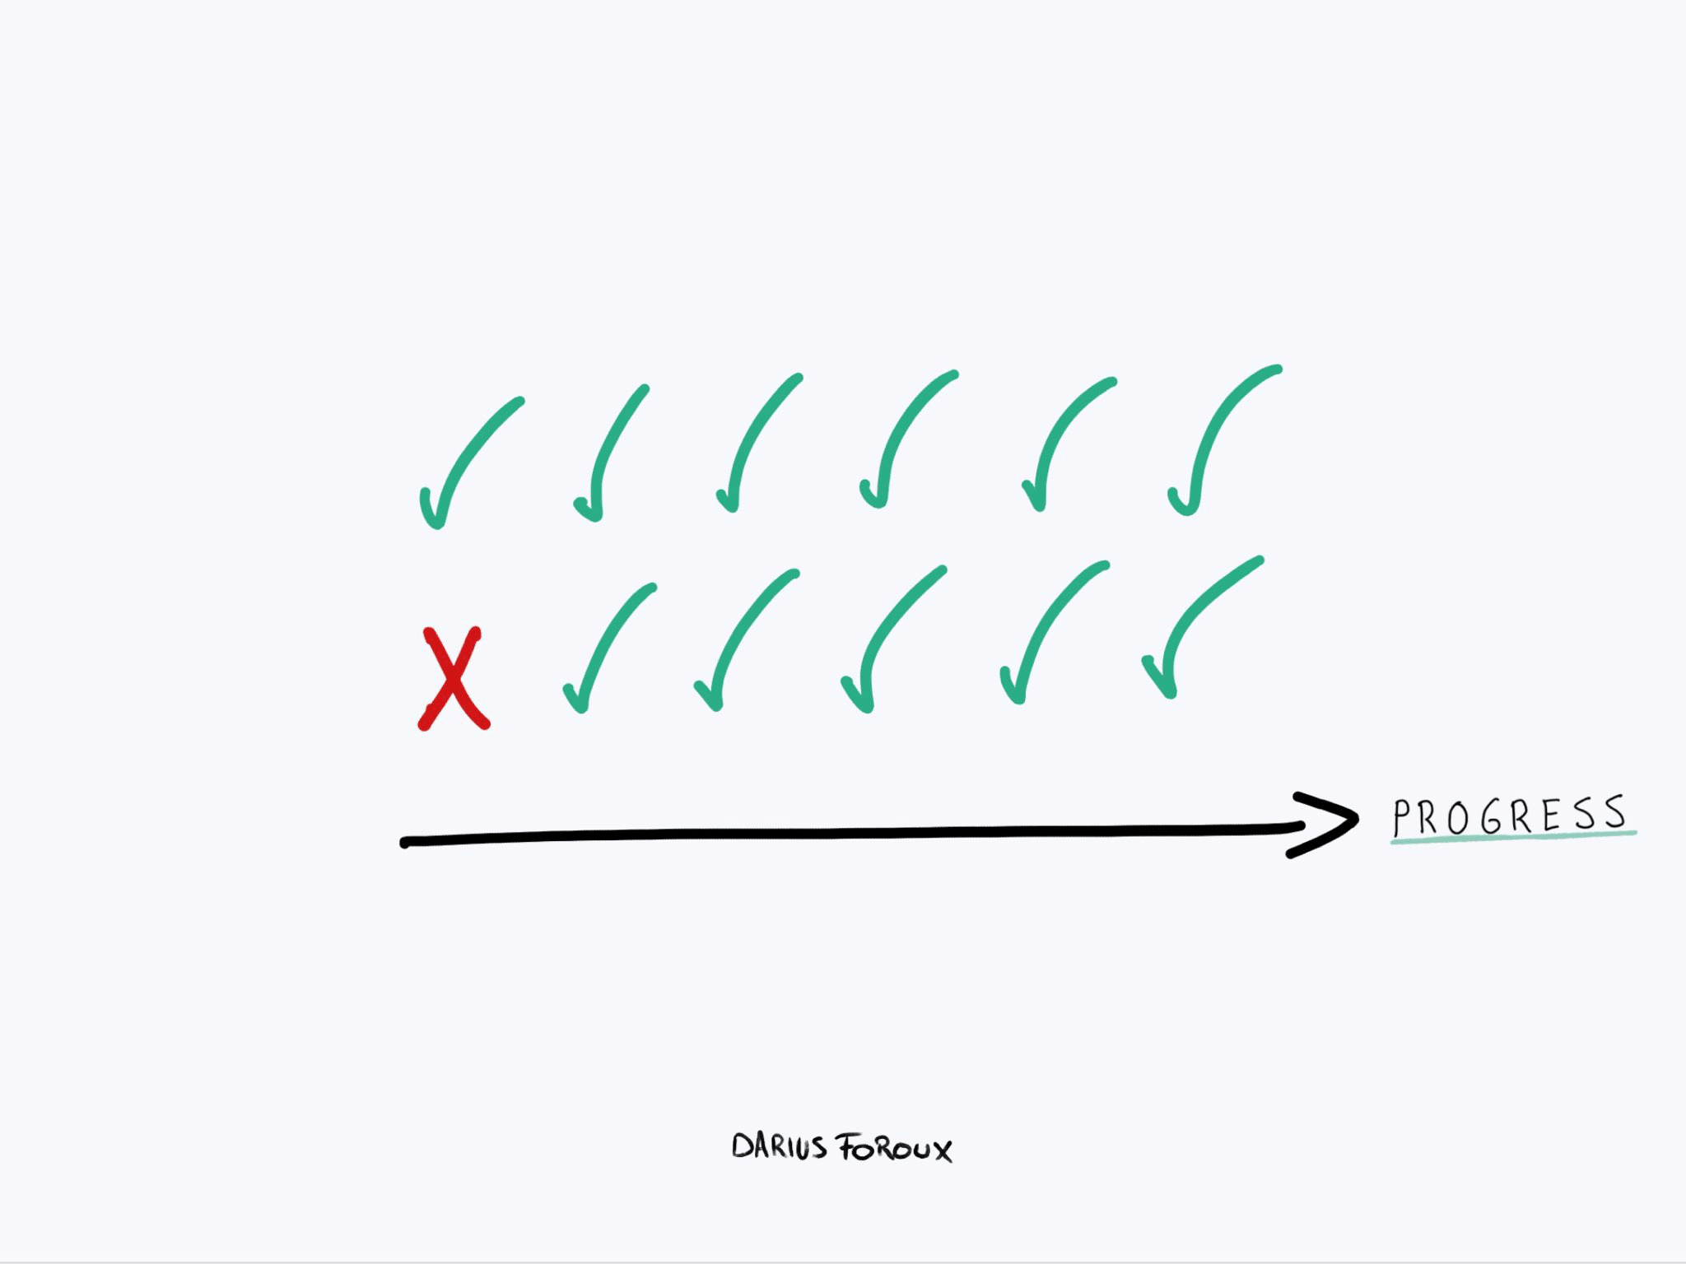


04
05
Missing Values
Duplicates
Inconsistent
Outliers
No values missing in the dataset
No duplicates in this dataset
Data was inconsistent, had to fix dataset
Some outliers but nothing to skew results
Solutions
I’ll cover some of the solutions I implemented to cleanse the dataset.

Slide 9
03
Transformation

Slide 10

Issues
Transformation fixes any unstructured data.
Convert text to numerical values
Add additional datasets
Joining and Merging data
Data format

Slide 11
Solutions
Methods used to structure data
BMI.Category
Fixing “Normal Weight ” into “Normal”
Heart Rate
Category had to be transform from char values into numerical values for calculations

Slide 12
04
Analyzes

Slide 13
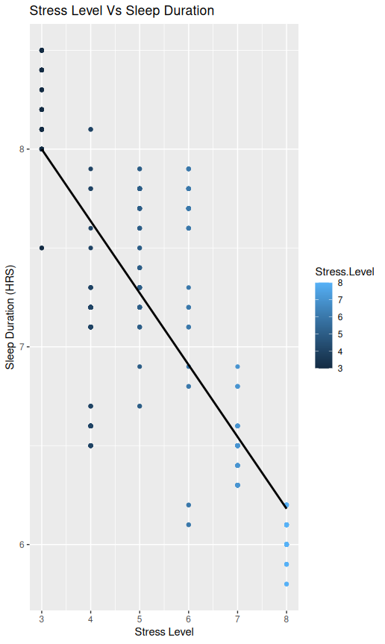
Stress Levels and Sleep Duration
INDUSTRY VALUE CURVE
STRATEGIC MOVE
Stress Levels Range 3- 8
Sleep Duration Range 5~ to 8~ hours

Slide 14
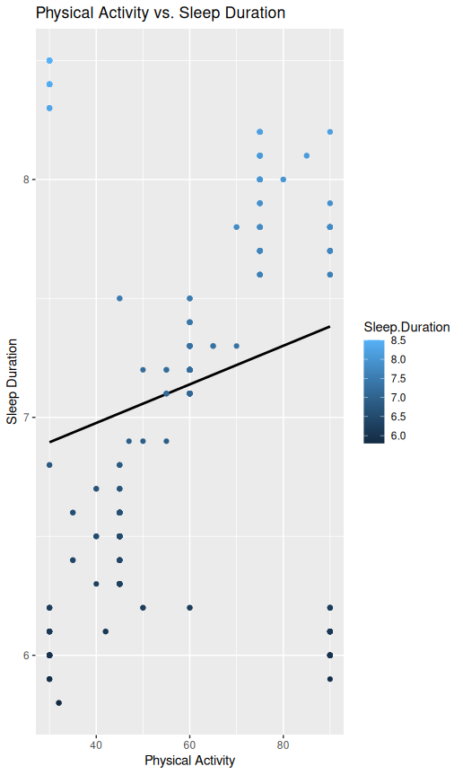
Physical Activity vs. Sleep Duration
INDUSTRY VALUE CURVE
STRATEGIC MOVE
Physical Activity Range 30 to 90
Sleep Duration Range 5~ to 8~ hours

Slide 15
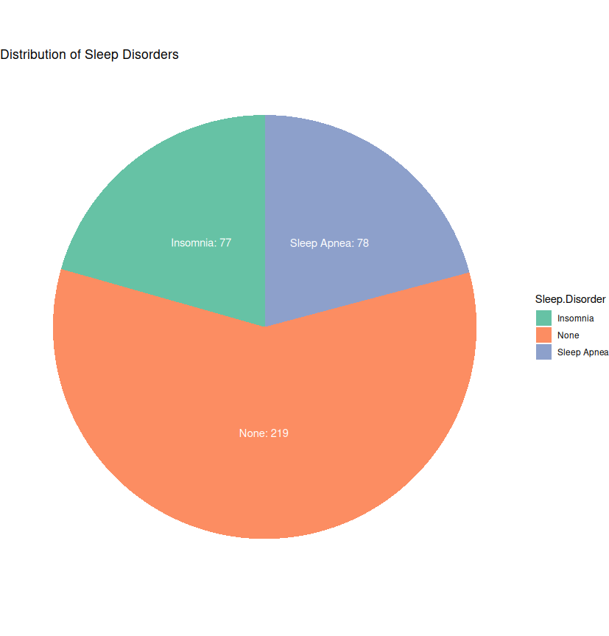
Interesting Charts
INDUSTRY VALUE CURVE
STRATEGIC MOVE

Slide 16
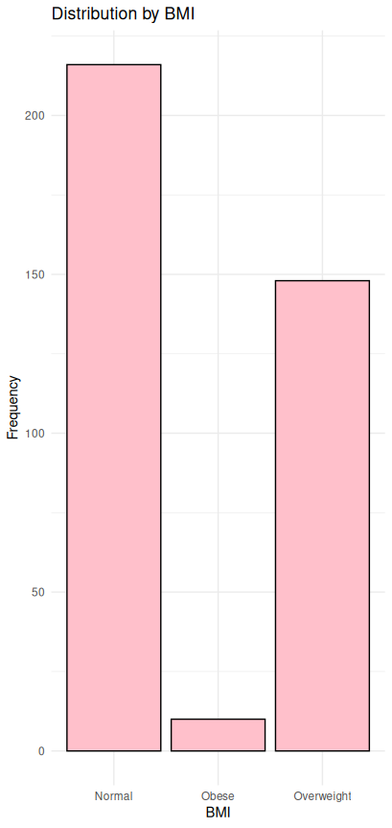
Interesting Charts
INDUSTRY VALUE CURVE
STRATEGIC MOVE

Slide 17
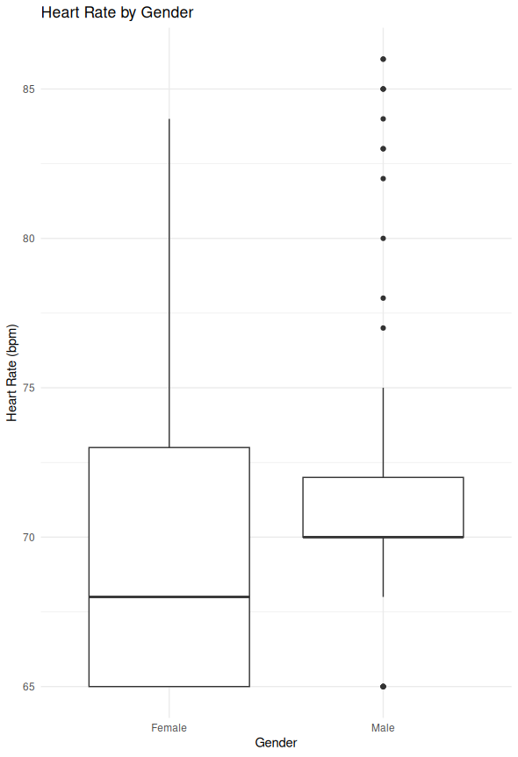
Interesting Charts
INDUSTRY VALUE CURVE
STRATEGIC MOVE

Slide 18
05
Storage

Slide 19

Github
https://github.com/AngelinCS/Project_UCLA

Slide 20
06
Final Thoughts

Slide 21
Questions?

Slide 22
THANK YOU
COMPANY NAME

